Slide 1
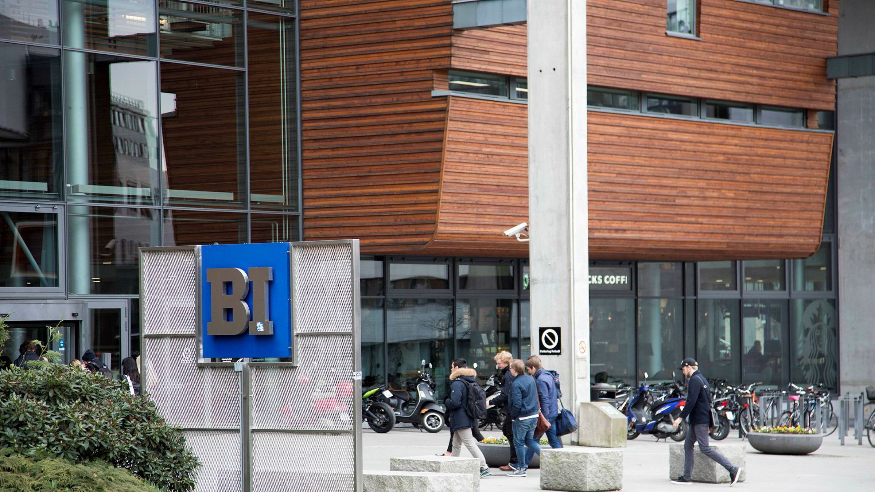
International commercial law: CISG – remedies for breach of contract
Miloš Novović, PhD
Associate Professor of Law, BI Norwegian Business School

Slide 2
Welcome!
Today’s lecture
We will introduce the concept of remedies under CISG
We will talk about damages – monetary compensation claims for harm suffered
We will consider defenses available, including impediment beyond control
We will speak about contract termination and fundamental breach
We will introduce other remedies, such as specific performance and price reduction

Slide 3
Reading materials
You should read text of CISG and Ch. 2 from Carr textbook (itsLearning).

Slide 4
Remedies:
what can you ask the courts to do?

Slide 5
Damages: monetary restitution

Slide 6
CISG: Monetary reimbursement (damages)
Buyer and seller always* have the right to request to be reimbursed for financial and non-financial harm they have suffered (damages).

Slide 7
Amount of damages
“A sum equal to the loss, including the loss of profit, suffered by the party as a consequence of the breach” (Art. 74)
However, this sum only includes “the loss which the party in breach foresaw or ought to have foreseen at the time of the conclusion of the contract, in the light of the facts and matters of which he then knew or ought to have known, as a possible consequence of the breach of contract.”

Slide 8
Discussion
Microsoft orders 1000 latest Intel chips at 100 USD per chip. The chips are manufactured using substandard materials and catch fire on the production line, destroying the assembly machine, worth USD 1 million. Microsoft then fails to launch latest Surface device before Christmas, missing out on additional 100.000 USD in profits.
You represent Microsoft. Which amount would you sue Intel for? Which amount are you likely to recover?

Slide 9
Amount of damages: Duty to mitigate
“A party who relies on a breach of contract must take such measures as are reasonable in the circumstances to mitigate the loss, including loss of profit, resulting from the breach. If he fails to take such measures, the party in breach may claim a reduction in the damages in the amount by which the loss should have been mitigated.” (Art. 77)

Slide 10
Discussion
Microsoft’s production machine is destroyed in a fire caused by faulty Intel chips. Machine is worth 1 million USD. However, Microsoft does not contain the fire, and the entire factory burns, causing a total loss of 10 million USD.
Which amount is Microsoft likely to recover?

Slide 11
CISG: Monetary reimbursement (damages)
Buyer and seller always* have the right to request to be reimbursed for financial and non-financial harm they have suffered (damages).
*But a party is not liable to pay for damages if they failed to perform their duties due to an “impediment beyond their control” (Art. 79, applies only to damages and not other remedies)

Slide 12
CISG: Impediment beyond control
Article 79
A party is not liable for a failure to perform any of his obligations if he proves that the failure was due to an impediment beyond his control and that he could not reasonably be expected to have taken the impediment into account at the time of the conclusion of the contract or to have avoided or overcome it or its consequences.

Slide 13
Examples
Intel ships chips to Microsoft. There is a sudden storm, the ship sinks, and the delivery of new chips is delayed. Microsoft loses profits.
Must Intel pay for the lost profits?
What if there had been severe storm warnings two days prior?
What if the chips could have been saved?

Slide 14
Examples
A Norwegian buyer orders 100.000 bananas from an American seller for 100.000 NOK. 1% of the bananas are infected with a dangerous parasite.
Norwegian buyer notifies of non-conformity of delivery and takes detailed photos to preserve as evidence. They do not separate healthy bananas from the infected ones, and 50% of bananas are lost. Buyer has lost 1 NOK per banana in profit.
How much is likely to be recovered as damages under CISG?

Slide 15
Remedies for buyer and seller

Slide 16
Termination of contract (avoidance)
The most serious and drastic remedy: releases both parties from their obligations, subject to any damages due
Goal: restitutio in integrum, restitution of previous situation (as if the contract were never concluded) – buyer gets the money back, seller gets the goods back + damages; no punitive goal
CISG disfavors “destruction of contracts”, and this is generally a measure of last resort – why?

Slide 17
When can you terminate the contract?
Option 1: when there is a fundamental breach by other party
Article 25
A breach of contract committed by one of the parties is fundamental if it results in such detriment to the other party as substantially to deprive him of what he is entitled to expect under the contract, unless the party in breach did not foresee and a reasonable person of the same kind in the same circumstances would not have foreseen such a result.

Slide 18
Fundamental breach
Very important concept, as it is practically required to terminate the agreement in some scenarios
Requires both a serious breach (substantially deprive of expectations) and foreseeability of consequences
Differently stated: to challenge termination of the agreement on grounds of fundamental breach, you would need to either prove that 1) the breach was not “serious”, or 2) neither you nor the reasonable person could have foreseen the consequences of breach

Slide 19
Examples
Intel ships chips to Microsoft. The agreed date of delivery is 15th of May. Chips arrive on 16th of May.
Fundamental breach?

Slide 20
Examples
Intel ships chips to Microsoft. The agreed date of delivery is 15th of May. Chips arrive on 16th of May, causing Microsoft to miss production target schedule, losing 1 million USD in profit.
Fundamental breach?

Slide 21
Examples
Intel ships chips to Microsoft. The agreed date of delivery is 15th of May. Chips arrive on 16th of May, causing Microsoft to miss production target schedule, losing 1 million USD in profit.
Contract: “Date of delivery is of paramount importance to Microsoft, and any lack to deliver on specified date will constitute a fundamental breach.”
Fundamental breach? What if the contract were silent, but this was said during negotiations?

Slide 22
When can you terminate the contract?
Option 1: when there is a fundamental breach by other party
Option 2: if the party did not deliver the goods or pay the price/take over the goods, you gave them an additional period of time to do so, and they failed to perform (Art. 49(1)(b)/64(1)(b))

Slide 23
Examples
Intel sells chips to Microsoft. The contract stipulates that the goods will be delivered by March 15th. Intel fails to deliver the chips on this date.
Microsoft gives Intel two more months to deliver the missing chips. Intel does not comply, saying they will deliver in September.
Can Microsoft terminate/avoid the contract?

Slide 24
When can you terminate the contract?
Option 1: when there is a fundamental breach by other party
Option 2: if the party did not deliver the goods or pay the price/take over the goods, you gave them an additional period of time to do so, and they failed to perform (Art. 49(1)(b)/64(1)(b))
Option 3: it becomes clear the other party will fundamentaly breach the contract in the future (anticipatory breach, Art. 72)

Slide 25
CISG: Anticipatory breach
Article 72
(1) If prior to the date for performance of the contract it is clear that one of the parties will commit a fundamental breach of contract, the other party may declare the contract avoided.
(2) If time allows, the party intending to declare the contract avoided must give reasonable notice to the other party in order to permit him to provide adequate assurance of his performance.
(3) The requirements of the preceding paragraph do not apply if the other party has declared that he will not perform his obligations.

Slide 26
Examples
Intel is selling chips to Microsoft. A delivery of 1000 chips has been promised for December 1st.
In March, Intel globally announces that it will be phasing its hardware division out. In June, they canceled orders from several big companies. In August, they announced to investors that the chips are out of stock and no new ones are being produced.
It’s September, and Microsoft’s payment is due under the contract.
What should they do?

Slide 27
Examples
A Norwegian buyer orders bananas from the US seller. Contract is for 1000 tons of bananas. Contract also calls for banana samples to be sent prior to the first delivery.
Sample bananas are nowhere near the quality the contract requires.
What should the buyer do?

Slide 28
Remedies
Termination (avoidance)
Fixing additional period of time (“cure”) – Art. 47/63
Request specific performance

Slide 29
Specific performance
The court will instruct a party to perform (or not perform) a specific action, as opposed to simply awarding damages
For example, the court may instruct a seller to actually send the goods over, or transfer the property rights
In some legal systems, courts are very hesitant to order specific performance
CISG Art. 28: “a court is not bound to enter a judgement for specific performance unless the court would do so under its own law”

Slide 30
Examples
You buy a unique painting for your museum
You order a custom-built oil pump
You order wine only sold by this particular seller

Slide 31
Remedies
Termination (avoidance)
Fixing additional period of time (“cure”) – Art. 47/63
Request specific performance
Request substitute goods/repair in case of non-conformity

Slide 32
CISG: Repair/replacement
Article 46
(1) The buyer may require performance by the seller of his obligations unless the buyer has resorted to a remedy which is inconsistent with this requirement.
(2) If the goods do not conform with the contract, the buyer may require delivery of substitute goods only if the lack of conformity constitutes a fundamental breach of contract and a request for substitute goods is made either in conjunction with notice given under article 39 or within a reasonable time thereafter.
(3) If the goods do not conform with the contract, the buyer may require the seller to remedy the lack of conformity by repair, unless this is unreasonable having regard to all the circumstances.

Slide 33
Remedies
Termination (avoidance)
Fixing additional period of time (“cure”) – Art. 47/63
Request specific performance
Request substitute goods/repair in case of non-conformity
Request price reduction

Slide 34
CISG: Reduction of price
Article 50
If the goods do not conform with the contract and whether or not the price has already been paid, the buyer may reduce the price in the same proportion as the value that the goods actually delivered had at the time of the delivery bears to the value that conforming goods would have had at that time.

Slide 35
Examples
Contract: 100 apples, 10 NOK each = 1000 NOK
Lower quantity: 90 apples
Lower quality: 5 NOK market price
Lower quantity and quality

Slide 36
Case study
reMarkable is a Norwegian company specializing in production of eInk tablet devices. They have recently announced their “Model II” tablet.
BOE is a Chinese electronics company supplying eInk displays. BOE and reMarkable entered into a sales agreement, where BOE sold 100.000 displays at 100 USD per unit to reMarkable. Under heading “essentially important terms”, the contract stipulated that all the screens would be delivered on May 1st.
Due to a global pandemic, BOE notified reMarkable that they would only be able to deliver 10.000 units on time. A high-profile journalist wrote that BOE had insisted that even sick employees come to work, leading to a temporary shutdown of three factories.
It’s April 1st. You represent reMarkable. CEO wants to know what kind of legal options against BOE you might have. What is your advice?

Slide 37
Thank you!
Milos Novovic
milos.novovic@bi.no
+47 974 22 223

